Slide 1
AI ILLUMINATORS Workshop
05 / 06 June 2025 By Goldman Sachs Engineering x IMDA
Notes:
YWLC – Young Women Leadership Connection

Slide 2
Please Download Material from
https://tinyurl.com/gs-imda-2025

Slide 3
Artificial Intelligence

Slide 4
Why do we need AI?
1
Fizz
3
Fizz
5
Fizz
Buzz
Fizz
9
1
Fuzz
Bizz
Fuzz
5
FuzzBizz
7
Fuzz
Bizz
What is “Fizz” and what is “Buzz”?
Given any input, can you write a program
that detects it automatically?

Slide 5
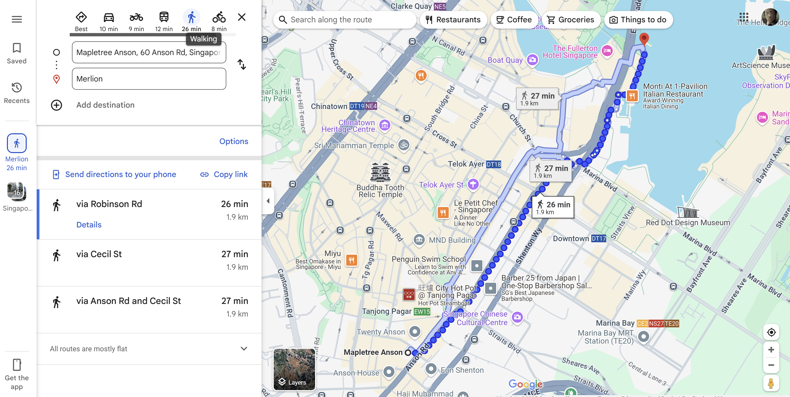
Why do we need AI?

Slide 6
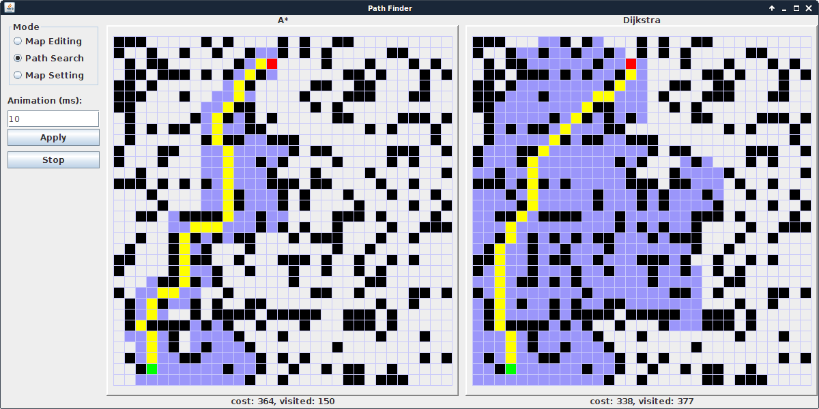
Why do we need AI?
Given a source and destination, how do we plan our shortest journey?
Common algorithms include Djikstra and A*

Slide 7

Demystify Ai, ml, nlp, dl
AI
Artificial Intelligence (AI) - broad discipline of creating intelligent machines.
Machine Learning (ML) - systems that can learn from experience.
Natural Language Processing (NLP) - systems that can understand human language.
Deep Learning (DL) - systems that learn from experience on large data sets.
ML
NLP
DL

Slide 8
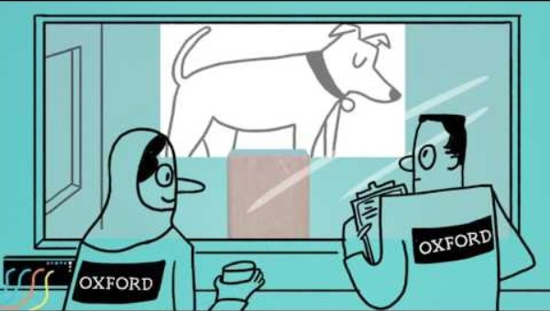
Machine Learning
https://www.youtube.com/watch?v=f_uwKZIAeM0

Slide 9
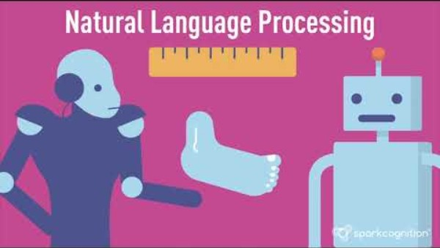
Natural Language Processing
https://www.youtube.com/watch?v=d4gGtcobq8M&t=100s

Slide 10
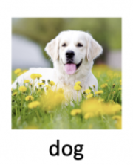
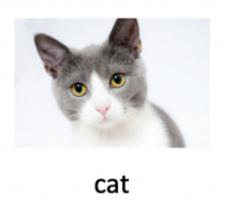
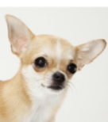
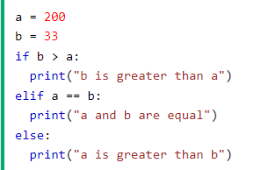
Learning Model
Traditional Programming
Learning Model
Test Data
Data
Training Data
Code
Results
Training
Model
Inference
Predictions
Rules
Expected Results
Model is like an equation used to make predictions
For e.g. if our goal is to create an application which sees an image and classifies if it is a cat or a dog,
We would pass tons of photos (Training Data) and its known types (Expected Results)
Our Deep Learning code will create a Model
When the Model sees a new image (Test Data) of an unknown type, it will run “Inference” to predict.
a and b are Data points
Conditional logic check is the Rule
“a is greater than b” is the output

Slide 11
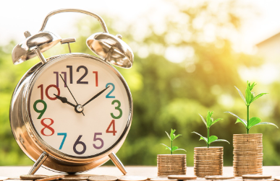
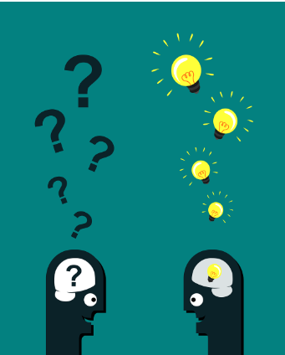
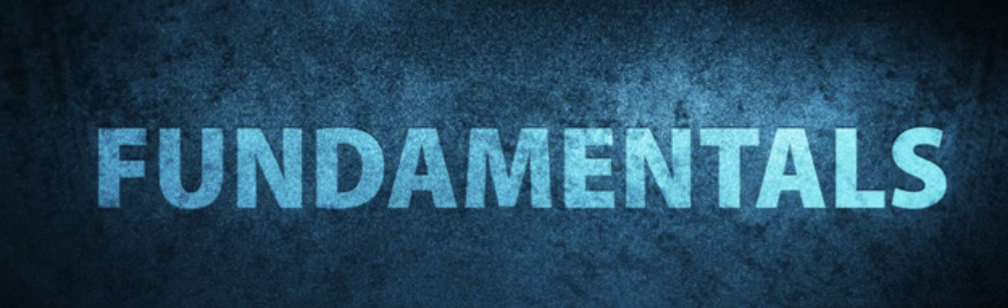

What do we need to build that app?
Python
Math (little bit)
Time
Deep Learning Platforms
Teamwork
Imagination

Slide 12
famous Deep Learning platforms
TensorFlow : Python, Javascript, C++, Java
Pytorch : Python
Keras : Python
What’s the pattern?

Slide 13
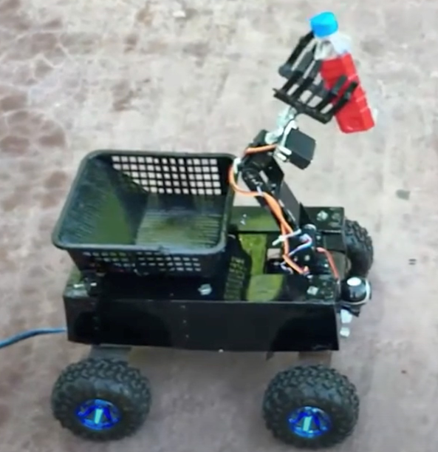
What will we build today ?
Simple image classifier
Extend to “Save the environment” !
For e.g. On a sea beach, detect plastic bottles, pickup the bottle/mark the spot for future clean-up !

Slide 14


Concepts
TF
TF
TFL
TFL
Train a model
Inference or Prediction
Convert the model
Deploy the Pre-trained Model
To be able to run on other devices
On Google Collab
Classify images
Step 1 Today
Step 2
Today

Slide 15
Bring it altogether!

Slide 16
Hands on
Pre-requisite
Refer to Google Colab notebook “MobileNet Image Classification” (tinyurl.com/gs-imda-2025-image)
Please click File → Save a copy in Drive to enable editing
Test the code
Download any image from the internet
Put in the test folder
See if the model is able to classify the image.
Advanced Exploration
If an image’s accuracy isn’t too high, what can be the reasons ?
Try out the image classification on Telegram chatbot

Slide 17
Collab Notebook Read-Only Links
BertQnA: tinyurl.com/gs-imda-2025-bert
Sentiment Analysis: tinyurl.com/gs-imda-2025-sentiment
Please click File → Save a copy in Drive to enable editing

Slide 18
Lunch break

Slide 19

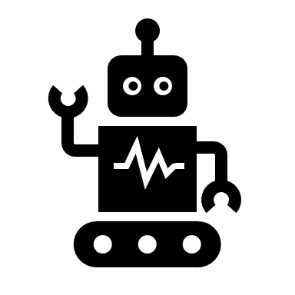


Sustain-a-bot

Slide 20
Sustain-a-bot
Craft a telegram bot that championing sustainability in Singapore. Your code is the beacon of hope, inspiring a greener, more resilient future for our city.
You can use all the concepts that have been covered during the workshop, i.e. Python, AI, Telegram Bot.
You will have 70 mins to create your bot and 5 mins to present it.
Q&A
Eco Tracker
… be creative!
Eco News/Tips
Game/
Challenges

Slide 21
Suggested Themes
Recycling
Biodiversity
Energy Management
Pollution
Waste Management
Water Management
Marine Resources
Circular Economy
Sustainable Products
Climate Change
.. and any other related topics!

Slide 22
Tips
Define Bot Functionality
Create Bot
Implement Bot
Demo
What is the purpose of the bot?
What features should the bot have?
Who is the target user?
Any specific data and knowledge base needed for the bot to function?
Make use of your Telegram Bot API key
Start implementing the reponses in the sendMessage() function
Raise your hand to get help from our volunteers.
Introduce your bot purpose and functionalities
Bot demo (if any)
Thoughts on future features and scalability
Notes:
AI agents help

Slide 23
photo

